Slide 1
Health Economics
New Investigators Course
4 August 2022
Dr. Annette Hay
Associate Professor, Queen’s University
Thanks to Natasha Leighl, Nicole Mittmann, Neal Reaume & Matt Cheung for contributed slides

Slide 2
Conflicts of Interest
Research funding from
Roche
AbbVie
Celgene
Merck
Seattle Genetics
Novartis
Karyopharm

Slide 3
Objectives
To consider what trial settings are appropriate for health economic analyses
To discuss the components of health economic analyses

Slide 4
Value in Health Care

Slide 5
Cost of health care and life expectancy
Total Life Expectancy at birth (years) 2017 data
% GDP spent on healthcare (2018 data)
Created 2020Nov9 using OECD 2020 statistics available online

Slide 7
Oliviera et al CMAJopen 2018

Slide 8
Perspectives on rising health care costs
Government
Tax payers
Patients
Pharmaceutical companies

Slide 9
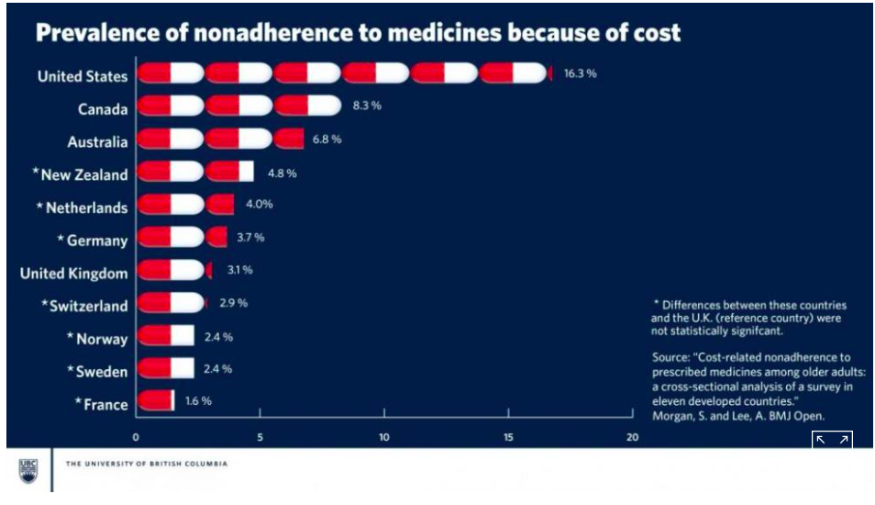
https://www.upi.com/Health_News/2017/02/01/Seniors-in-US-Canada-skip-prescriptions-due-to-cost/ 5081485956011/ accessed 2019Nov10 07.33

Slide 10
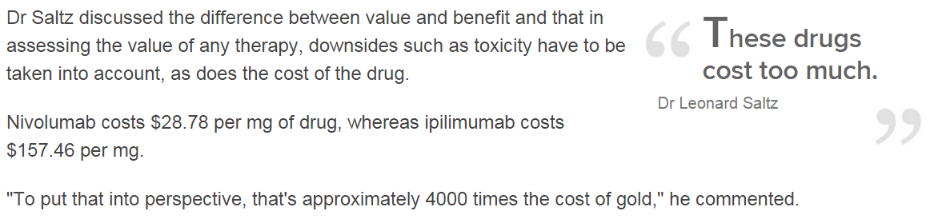

Perspective on Value

Slide 11

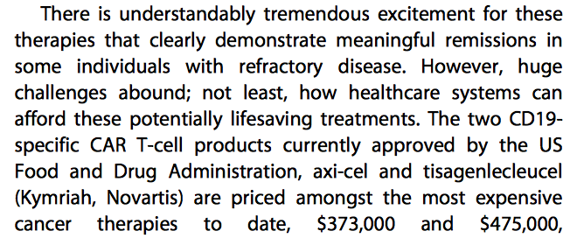
Hay A, Cheung M. Med J Econ 2019

Slide 12
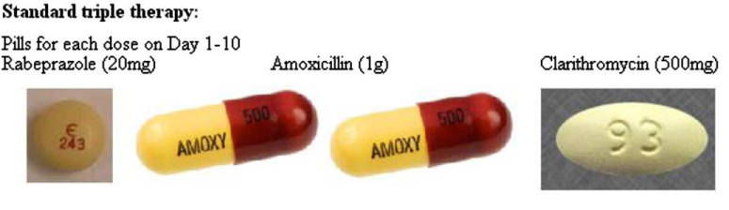

Antibiotic therapy for Helicobacter pylori associated gastric MALT lymphoma
Eradication of H. pylori bacteria with antibiotics leads to complete remission of lymphoma in 69-90% of cases
Nakamura, Gastroenterol Clin North Am 2015

Slide 13
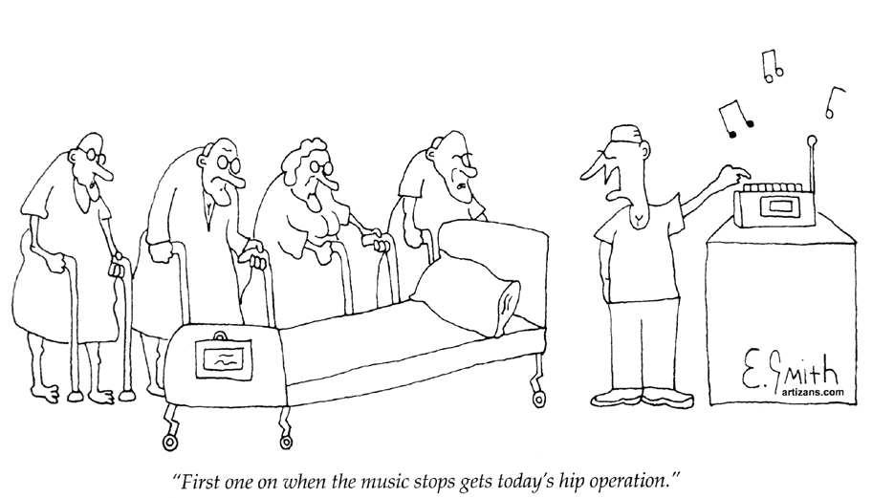
Notes:
Need to figure out some way to distribute available resources across country, patients and diseases, ideally equitably and with maximal gain. Could play musical chairs or could try a more scientific approach.

Slide 14
What if anything can clinical trial researchers to do to help?

Slide 15


Slide 16
Economics and Cancer
New treatments that improve outcome should be adopted
But with limited resources, economic constraints factor into resource allocation, in order to maximize population health
US - 3 pillars of FDA approval of novel interventions:
        Safety
        Mechanism of action
        Clinical efficacy
        4 Cost-effectiveness
        expression of an intervention’s cost in relation to its benefit
        additionally considered in Canada

Slide 17


Incremental Cost Effectiveness Ratio (ICER)
Δ cost between option A and option B/ Δ benefit
Treatment A costs $10,000 - B $8,000
A improves survival by 1 year, quality-adjusted survival by 0.8 yrs
ICER – $2,000/LYG; $2,500/QALY
Notes:
When you have a choice to make…
CEA often used as a generic term
Allows us to factor in quality of life and toxicity issues – better cured and off tx than endstage on platinum
Most cancer patients – adjustment is lower – 0.5-0.6 if well, 0.3 or 0.4 if not well

Slide 18
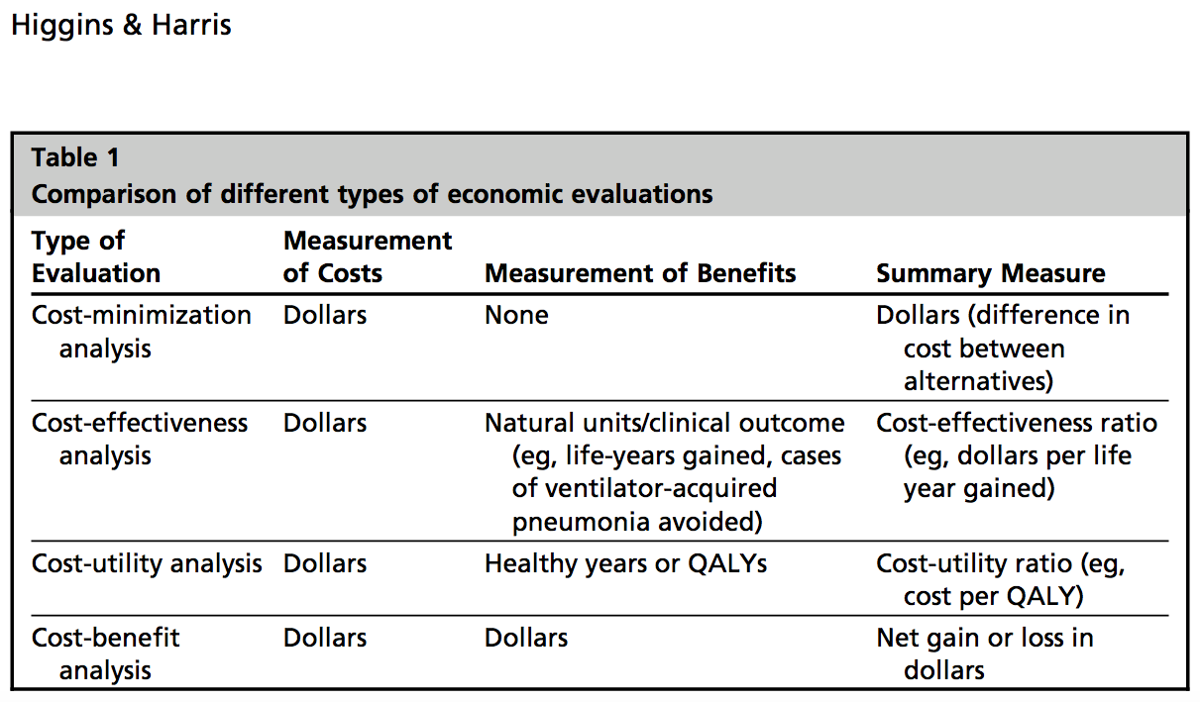
Higgins & Harris 2012
Notes:
Cost-minimization analysis (CMA) – Outcomes of intervention & alternatives are considered equivalent; alternative with lowest cost is selected
Cost-effectiveness analysis (CEA) – outcome measured units, e.g. life- years gained or clinical event avoided; sometimes used to refer to all economic evaluations
Cost-utility analysis (CUA) – outcome measured in terms of health related preference or value, e.g. quality-adjusted life-years
Cost-benefit analysis (CBA) – values net benefits and opportunity costs in monetary terms

Slide 19
Components of an Economic Analysis
Select type of analysis (CUA, CEA, CMA)
Perspective – Societal; Payer (government), Patient
Prospective or Retrospective or Administrative Data Collection
Costs – direct and indirect medical, lost productivity
Time Horizon – lifetime; duration of clinical trial
  What about after trial? Adjuvant – late effects, relapse and treatment
Outcomes – survival in Phase III trial; (what about PFS in phase II?)
  How do you value survival with cancer vs. cancer-free? Utilities, QALY
  What about value of PFS, RR? Time with toxicity?
  What comparator(s) should be used?
Discounting – used for valuation of future costs, benefits
Uncertainty – 95% confidence intervals, sensitivity analyses

Slide 20
Quality Adjusted Life Year (QALY)
Integrates mortality and morbidity
QALY= duration of health state * utility score during that health state
1 year with disease = fraction of a healthy year
Considers impact on quality of life
Considers impact of toxicity

Slide 21
Health Preference (Utility)
Measure of health preference
      1-perfect health
      0-death
      Average Canadian 0.92-0.96
      Changes according to disease state
Standardized tools available to measure
      Direct-Time Trade Off, Standard Gamble
      Indirect-HUI, EQ5D, VAS

Slide 22
Adopting a New Technology
⬆Cost
New intervention less effective, more costly
New intervention more effective, more costly
New intervention less effective, less costly
New intervention more effective, less costly
✗
?
⬇QALYs
⬆QALYs
✗
✓
⬇Cost
Laupacis et al. CMAJ 1992

Slide 23
League Table
INTERVENTION | COST/life-yr gained
Bone marrow transplant | $220,000
Inpatient hemodialysis | $ 54,000
Neonatal ICU | $ 30,900
Automoblie airbags | $ 20,000
Treatment of mild hypertension | $ 19,100
Treatment of severe hypertension | $ 9,400
Bypass surgery (left main) | $ 4,200
Mandatory smoke detectors | $ 1,300
Smoking cessation counselling in men | $ 705

Slide 25
CCTG economic analyses examples

Slide 26
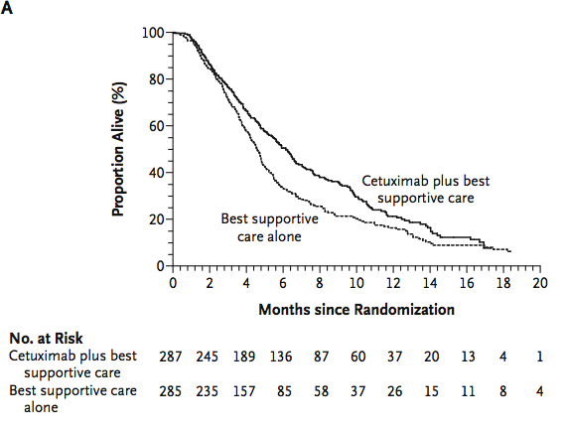
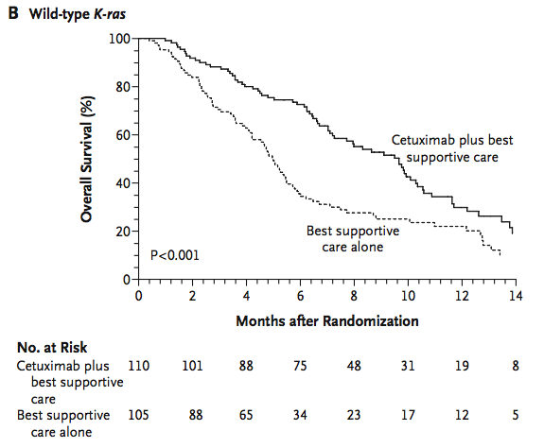
NCIC CTG CO.17: Cetuximab improves survival and quality of life in end-stage advanced colorectal cancer; greatest benefit in KRAS wild type (not KRAS mutant)
Entire Study Population (unselected)
HR 0.55 (95% CI 0.41-0.74)
v. 0.98 (95% CI 0.70-1.37) in KRAS mutation +
Test for interaction, p=0.01
HR 0.77 (95% CI 0.64-0.92)
69% tumour samples (394/572), similar characteristics to overall population
58% KRAS wild type of those tested (230/394), 40% of entire study population
Jonker DJ et al. NEJM 2007
Karapetis CS et al. NEJM 2008
Notes:
99.9% received Rx in entire population; 100% in wild type
31% - hospital wouldn’t release; patient didn’t give consent or died before could give it; insufficient sample

Slide 27
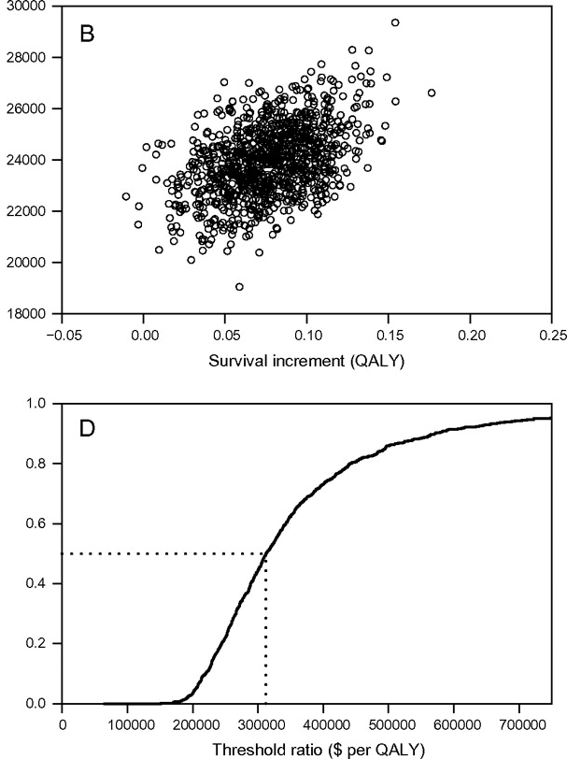
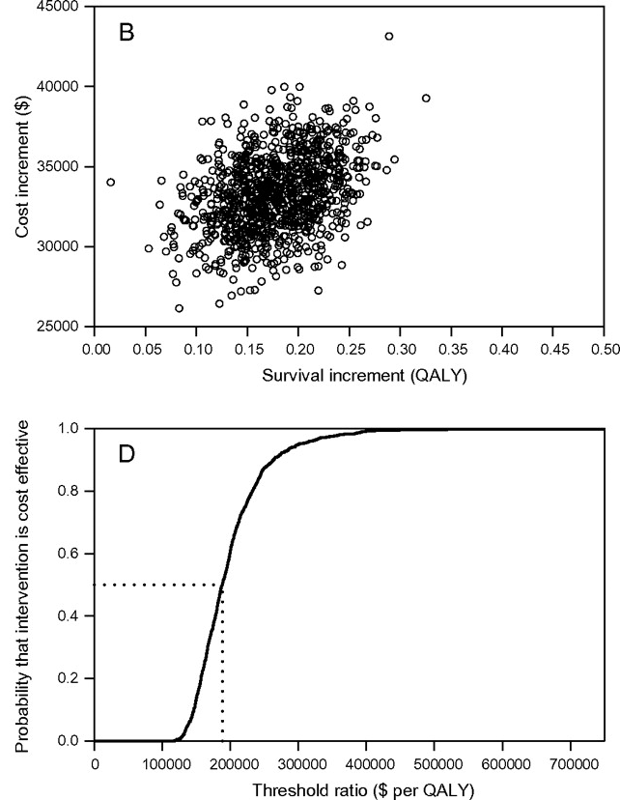
Prospective Economic Evaluation (resource utilization, HUI3) of Cetuximab Therapy in the entire study population and KRAS wild type subgroup
ICUR $300,000/QALY ICUR $187,000/QALY
Entire study population KRAS wild type
(n=572) (n=230)
Mittmann et al. JNCI 2009
Notes:
Primary Endpoint: to determine the incremental cost-effectiveness (cost per life year gained and cost per quality adjusted life year) of cetuximab compared to best supportive care in the NCIC CTG CO.17 trial
Prospective collection of health preference values during trial using Health Utility Index (HUI)
Methods: Prospective resource utilization collection, retrospective costs in 2007 Canadian $ ($1 CAN=$1 US)
Perspective: Canadian public healthcare system
Time horizon: From randomization until death or last date of enrolment (March 2006)

Slide 28
BR.21: Erlotinib vs. Placebo in pretreated advanced non-small cell lung cancer
1.00
Erlotinib
Placebo
(n=488)
(n=243)
Median survival (mo)
6.7
4.7
0.75
1
-
year survival (%)
31.2
21.5
RR 8.9%, improved QL
0.50
HR=0.70 (95% CI, 0.61-0.86)*
P<0.001†
Survival distribution function
0.25
Erlotinib
Placebo
0
0 6 12 18 24 30
Months
*From Cox regression model.
†From 2-sided log-rank test.
HR = hazard ratio.
Shepherd et al, NEJM
Notes:
28
Median survival was improved by 42.5% and was longer in patients who received TARCEVA compared with patients who received placebo: 6.7 vs 4.7 months, respectively.
The HR in survival analysis is a summary of the difference between 2 survival curves, representing the reduction in the risk of death on treatment compared with control over the period of follow-up. It is a form of relative risk.
The HR for OS in the TARCEVA arm relative to the placebo arm was 0.70 (95% CI, 0.61 to 0.86) (P<0.001), indicating that TARCEVA reduced the risk of death by 30% compared with placebo during the study or follow-up periods.
The HR is from the Cox regression model with the following covariates: ECOG performance status, number of prior regimens, prior platinum, best response to prior chemotherapy.
The P value is from the 2-sided log-rank test stratified by ECOG performance status, number of prior regimens, prior platinum, best response to prior chemotherapy.
Note that EGFR protein expression status was not considered as a stratification factor in the stratified log-rank test because the status was missing in 55% of the patients.
Survival was evaluated in the intent-to-treat population.
TARCEVA™ [package insert]. Melville, NY, and South San Francisco, Calif:
OSI Pharmaceuticals, Inc., and Genentech, Inc.; 2004.
Data on file (BR.21 study report), Genentech, Inc.

Slide 29
Mean Costs per Treatment Arm
CAD$

Slide 30
Canadian Cancer Trials Group LY.12
Patients with relapsed or refractory aggressive lymphoma
(R)DHAP
(R)GDP
R₁
Stem cell transplant
Non-inferiority design
Hypothesis: Equally efficacious, less toxic, less costly
Co-Primary endpoints: response rate and transplantation rate
Notes:
Study Question

Slide 31
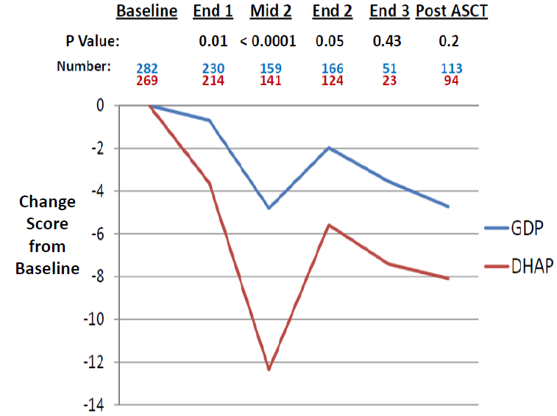
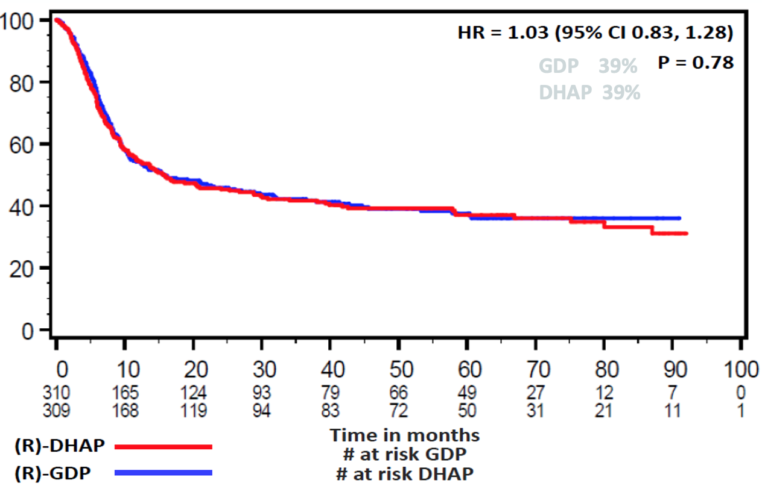
LY.12 Outcomes
Efficacy:
GDP is non-inferior to DHAP
Quality of life:
GDP is superior to DHAP
N=619 | (R)DHAP (%) | (R)GDP (%) | P-value
Response rate non-inferiority | 44 | 45.2 | 0.005
Transplantation rate superiority | 49.3 | 51.8 | 0.49
Overall survival
Overall survival

Slide 32
Embedded Economic Analysis Question Options
Cost-minimization analysis from payer perspective
What is the difference in cost associated with administration of (R)DHAP or (R)GDP chemotherapy to patients with relapsed or refractory aggressive lymphoma who are fit for autologous stem cell transplantation?
Cost-utility analysis from payer perspective*
In the same population, how does cost per quality-adjusted life-year differ between arms?
Cost-utility analysis from societal perspective
Include lost productivity and caregiver costs

Slide 33
Design
Public payer perspective
ITT analysis
Canadian subset of patients
Resource utilization data derived from case report forms
Direct medical costs applied to resource utilization data
    Costs obtained from Canadian/provincial databases
    Time-horizon (randomization to mobilization)
    2012 CDN dollars (no discounting)
Outcomes – survival (discounted at 5%/year)
Utilities – translated from FACT-G
Sensitivity analyses
Dobrez et al., Val Health 2007

Slide 34
Costs in 2012 Canadian Dollars
 | Cost | Source
Hospitalization* | $1144.11 to $1458.07 / day | Ontario Case Costing Initiative
ER visit** | $166.57 | Canadian Institute for Health Information Survey 2005
Home visit | $19.91 | Ontario Schedule of Benefits Working in Canada
Office visit | $24.46
Transfusion Red blood cells Platelets Additional OP cost | $422.47 $355.52 $50.42 | BloodyEasy Canadian Blood Services Sunnybrook Hospital
Concomitant medication | Individually costed | Alberta Health Interactive Drug Benefit List
Chemotherapy DHAP GDP | $11,161.24 $12,237.01 | Ontario Drug Benefit Program Pharmacist salary Cancer Care Ontario
}
* Limitation: ICU admissions not known
** Adjusted for inflation
Overhead costs included
Notes:
Hotel approximation method
Chemotherapy costs do not include hospitalization (avoiding double counting)
Concomitant medication associated with lymphoma (i.e not antihypertensives, etc)
Cost of chemotherapy includes pharmacist time to make it up and dispense

Slide 35
Direct Costs
Δ$14,464
p<0.0001
$21,890
$7,530
$9,849
$8,361

Slide 36
Quality of Life: Methods
Use of Functional Assessment of Cancer Therapy – 0-4 point scale
FACT-G 27 items
FACT-CNS 12 items
FACT-LYM 27 items
Assessed at: Baseline
End of cycle 1
Middle of cycle 2
End of cycle 2 (and 3 if applicable)
1 month post-transplantation
Notes:
Quality of Life was measures using the Functional Assessment of Cancer Therapy instrument, which includes items that include a 0 to 4 point ordinal scale
The FACT-G instrument includes 27 items that cross these 4 domains, and can be summed into a total score, which is what will be reported today
We also includes the FACT-CNS and FACT-Lymphoma scales and these will be included in a subsequent report.
Patients completed these instruments at the times shown here.

Slide 37
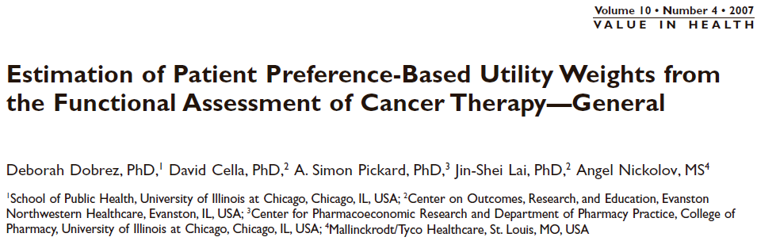
Require scores for questions #1 (PWB energy), #6 (PWB ill), #21 (FWB work), #23 (FWB enjoy life)
Utility = 1 +
  (-0.2222 if q1 = [3,4] or -0.1137 if q1 = [1,2]) +
  (-0.1537 if q2 = 4) +
  (-0.0431 if q3 = [0,1]) +
  (-0.1254 if q4 = [0,1] or -0.0641 if q4 = 2 or -0.0345 if q4 = 3)

Slide 38
Primary Outcome – Cost-utility
 | GDP | DHAP | Difference
Cost | $19,961 | $34,425 | - $14,464 (-20,250 to -9,726; p<0.0001)
QALYs | 0.161 | 0.152 | +0.01 QALYs (p=0.146)
ICER |  |  | GDP is dominant

Slide 39
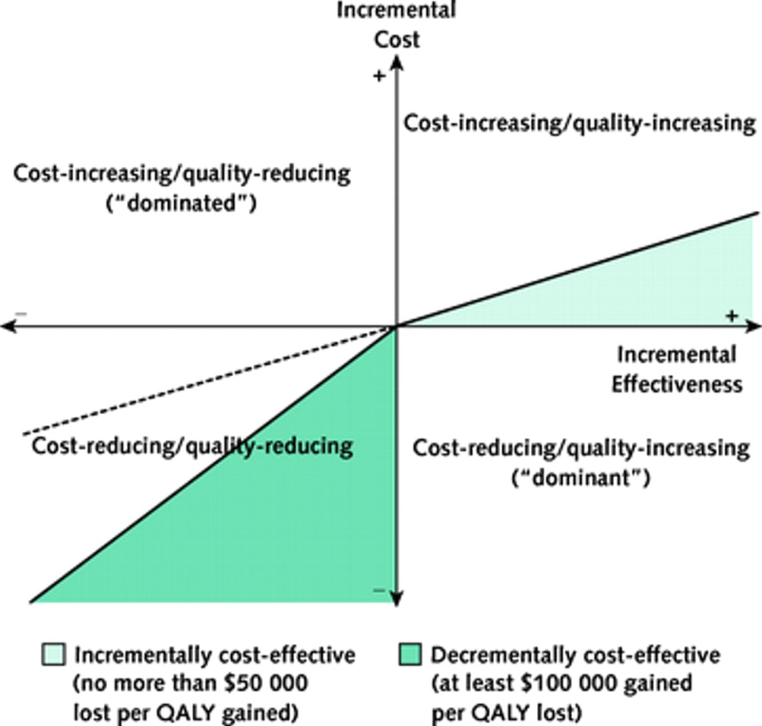
LY.12 results on cost-effectiveness plane

Slide 40
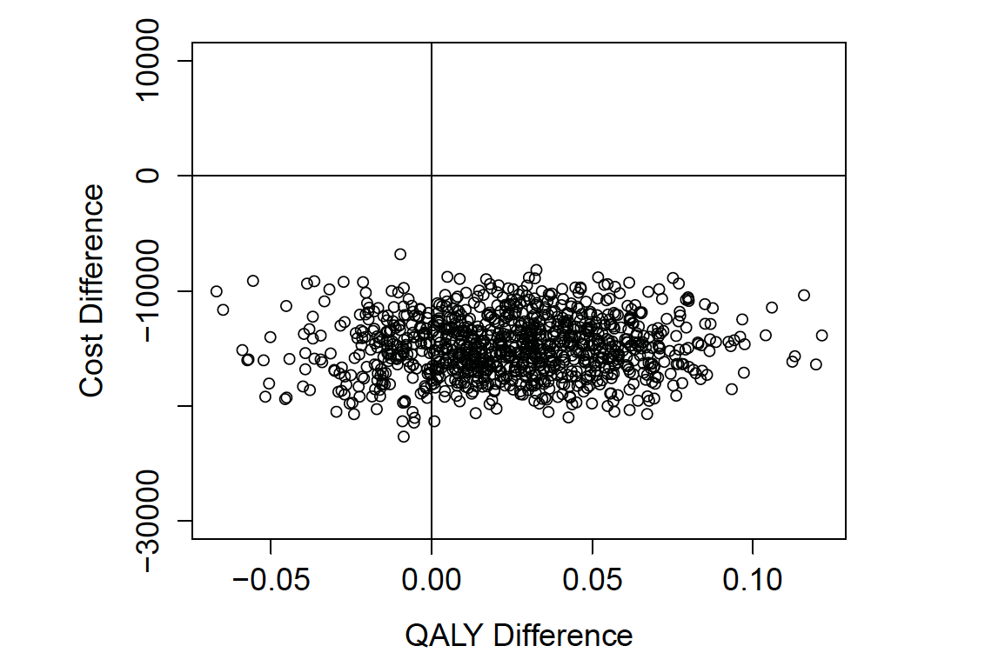
Sensitivity Analyses
Varying
Time horizon
Costs
Survival
Discounting
Bootstrapping
Notes:
Time horizon for survival analysis extended beyond stem cell mobilization. Post ASCT utilities modled at 1-month post transplant and applied to both GDP and DHAP arms equally (since core LY.12 study showed no difference in outcomes post SCT between arms).
Findings – GDP remained dominant in 79.7% of bootstrap replicates when utility was modeled at 0.1
Unit cost of hospitalization varied from min to max applicable
Major cost drivers and mean survival varied by +/- 20%
Discounting rates varied for costs and effects (0-5% or 2-8%)

Slide 41
Wrapping up

Slide 42
If adding health economic analysis to your protocol
Consider with support
Perspective: payer, patient, society
Analysis:
        Cost minimization - $ difference
        Cost effectiveness - $ per life year gained
        Cost utility - $ per quality adjusted life year gained
        Incremental cost effectiveness ratio = difference in cost
        difference in benefit
Time horizon
Cost components

Slide 43
Economic Analyses in Clinical Trials
Important addition to strengthen, complement results of ongoing clinical trials
Helps clinicians, patients and policy-makers interpret value of novel interventions
Critical part of Canadian oncology drug funding process (pan Canadian Oncology Drug Review)
Timely economic evaluation of interventions may facilitate uptake of novel therapies

Slide 44

Optional further reading

